Slide 1
Gaining Insights from a
Spotify Database
Or how to look for the next best-selling track

Slide 2
‘Moneyball’ for Tracks
bass

Slide 3
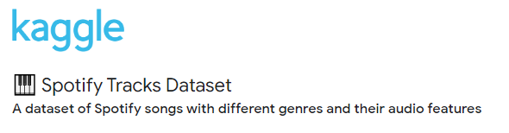
How to Create
the Perfect Track
Step 1- Get the data
Genre
Popularity
Explicit Lyrics
Valence
Duration
Live performance
Energy
Instrumental
Loudness
Danceability
Tempo (BPM)

Slide 4
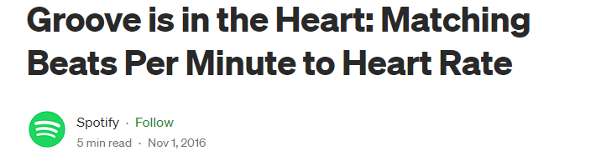
How to Create
the Perfect Track
Step 2- Work the data
Top 1000 Most Popular
mean duration =3.5 min
mean danceability =0.64/1
mean instrumentalness= 0.03/1
mean energy =0.67/1
mean tempo= 120 BPM
120 BPM
mean live =0.17/1

Slide 5
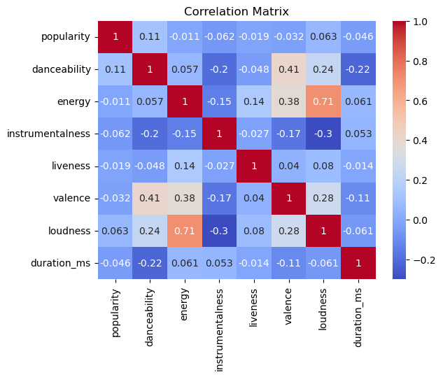
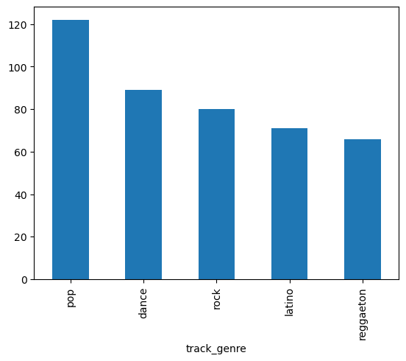
Step 2 and a half- Work it (the dataframe)

Slide 6
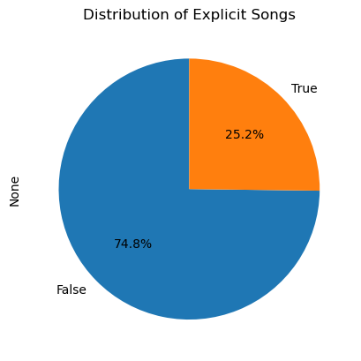
How to Create
the Perfect Track
Step 3- Conclusions
List of qualities:
~3.5 min
120 BPM tempo
Danceable
Energetic (?)
Studio performance
With lyrics
A bit loud
Pop/Dance/Rock/Latino
Peking Duk

Slide 7
Thank you!

